Slide 1
Department of Computer Engineering
New Horizon Institute of Technology and Management
University of Mumbai
“Subnautican Adventures”
By
Sr. No. | Name of the Student | IEN No.
1 | Sana Girish | 12242001
2 | Anish Shinde | 12212033
3 | Aradhana Shrivastav | 12212001
Guided by:
Mrs. Prajakta Yadav
26/03/2024

Slide 2
Outline
Sr no. | Topic | Page no.
1 | Introduction | 3
2 | Problem Statement and Objectives | 4-5
3 | Workflow | 6
4 | Hardware and Software Requirements | 7
5 | Implementation plan | 8-9
6 | Reference | 10
26/03/2024

Slide 3
Introduction
Welcome to the depths of the ocean, where adventure awaits in "Subnautican Adventures” ! In this underwater-themed game, players dive into an immersive world where they take control of a submarine, navigating through treacherous waters filled with obstacles and marine life.
Players must tap or click to control the submarine's ascent and descent, maneuvering carefully through narrow passages and avoiding collisions with dangerous obstacles. But beware, the depths are teeming with challenges! From menacing sharks to elusive octopuses, players must navigate past a variety of obstacles that threaten to impede their progress. Each collision with an obstacle diminishes the submarine's life, adding an element of strategy and urgency to the gameplay.
Are you ready to dive into the depths and embark on a thrilling underwater adventure? Prepare to test your skills, navigate the dangers, and discover the wonders that lie beneath the surface in "Subnautican Adventures"!
26/03/2024

Slide 4
Problem Statement and Objectives
Problem Identification :
The problem identified here is the need for a new, engaging game that offers a fresh take. There is an opportunity to introduce variation and innovation to the genre to attract players who enjoy simple yet challenging gameplay experiences. Additionally, there is a demand for games with underwater themes that allow players to explore and interact with marine environments..
Problem Solution :
The solution to this problem is the development of "Subnautican Adventures," a game that takes the addictive gameplay mechanics and introduces an underwater theme with submarines navigating through obstacles. By incorporating submarine marine creatures like sharks and octopuses as obstacles, the game offers a fresh and immersive experience for players. The addition of a life system, where collisions with obstacles reduce the submarine's life, adds a layer of challenge and strategy to the gameplay..
26/03/2024

Slide 5
Problem Statement and Objectives
Problem Definition :
The problem to be addressed is the lack of variation and innovation within the simple gaming market, particularly in the genre of simple yet challenging arcade-style games. There is also a demand for games with underwater themes that provide players with opportunities for exploration and adventure. Additionally, existing games may not fully capitalize on the potential for engaging gameplay experiences within underwater environments..
Objectives :
Develop an Engaging Gameplay Experience: Create a game that captivates players with its addictive gameplay mechanics and underwater theme, keeping them entertained and challenged.
Incorporate Unique Features: Introduce unique elements such as submarines, marine obstacles, and a life system to differentiate it from other games in the genre.
Enhance Player Immersion: Provide players with an immersive experience by designing visually appealing underwater environments and incorporating realistic sound effects.
Promote Strategic Gameplay: Encourage players to strategize and improve their skills by navigating the submarine through obstacles while managing its life meter.
26/03/2024

Slide 6
Workflow
START
Submarine
Generation
Obstacle
Generation
Obstacles are generated and shift left
Button input
YES
Submarine survives obstacles and remain in screen
NO
GAME OVER and your score
26/03/2024

Slide 7
Hardware & Software Requirements
Hardware Requirements:
Processor (CPU): Any modern processor capable of running the required software smoothly. Minimum requirement: Intel Core i3 or equivalent.
Memory (RAM): Sufficient RAM to handle game assets, code execution, and other system processes. Minimum requirement: 2 GB RAM.
Graphics Processing Unit (GPU): A basic GPU capable of rendering 2D graphics. Integrated graphics should suffice. Minimum requirement: Integrated Intel HD Graphics or equivalent.
& Storage, Input devices, etc.
Software Requirements:
Operating System: Windows
Game Development Engine : Unity
Integrated Development Environment (IDE): A code editor or IDE for scripting and programming game logic : Visual Studio Code (By C# )
& Graphics , audio software, web browser, etc.
26/03/2024

Slide 8
Implementation Plan
Dates | Implementation
05/02/24 - 09/02/24 | Topic Finalisation - “Subnautican Adventures” topic has been finalized.
12/02/24 - 16/02/24 | Literature Survey
19/02/24 - 23/02/24 | Language Study – C#
26/02/24 - 01/03/24 | Back End - na
11/03/24 - 15/03/24 | Front End - VS Code
18/03/24 - 22/03/24 | Implementation
26/03/24 - 29/03/24 | Implementation
26/03/2024

Slide 9

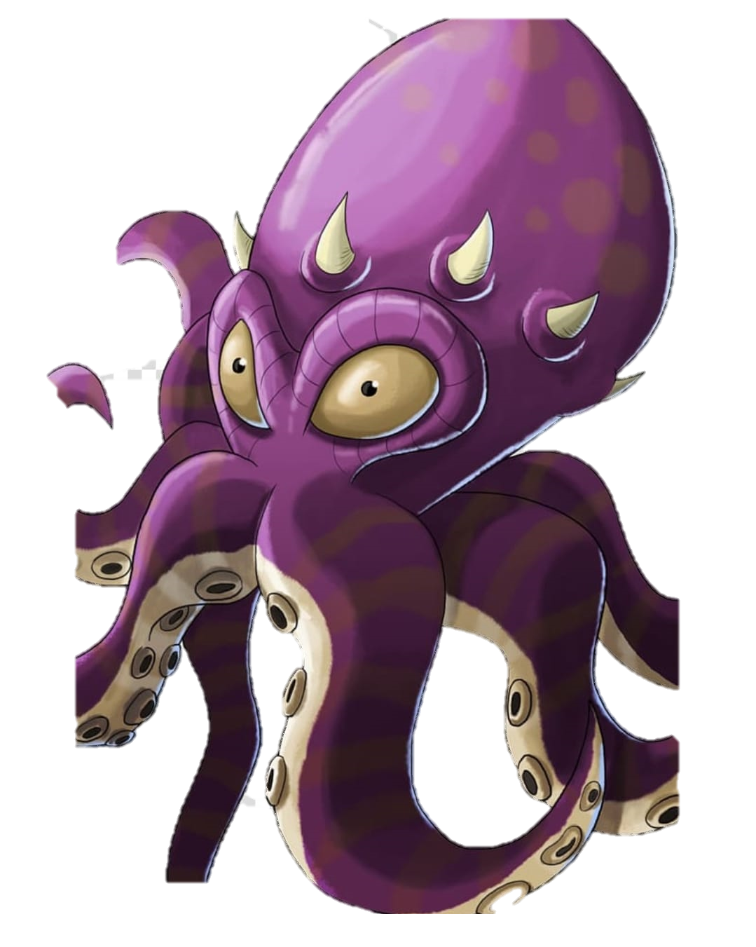
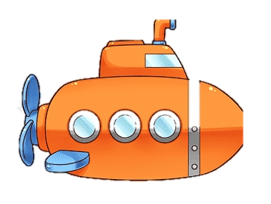

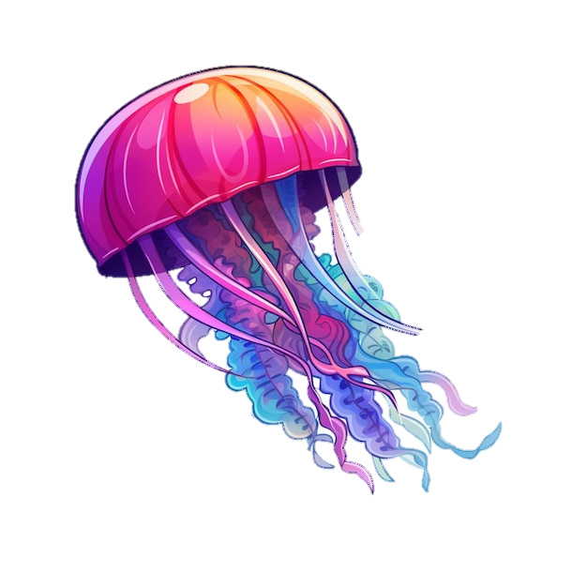
Implementation Plan
26/03/2024

Slide 10
References
For Underwater Game Design:
"Designing Underwater Game Environments: A Review of Best Practices" (Journal Article) by A. Smith and B. Johnson
For Arcade-Style Gameplay:
"Understanding Arcade Games: A Comprehensive Guide to Classic Coin-Operated Games from the 1970s to the 1990s" by David Lamkins
For Game Development and Programming:
"Unity in Action: Multiplatform Game Development in C#" by Joe Hocking
26/03/2024

Slide 11
THANK YOU!
26/03/2024

